Slide 1
Reduce
10 Smart Tips to
Food Waste
AT HOME

Slide 2
Create a List First
Don’t do over shopping or impulse shopping. Make a GROCERY list by taking the stock from your kitchen and do the shopping Overbuying is the main culprit, it leads to wastage.

Slide 3
Plan Your Meals
60% of the food is thrown away because it’s passed its “expiry” date so it always advisable to plan your meals wisely keeping the “best before” date in mind.

Slide 4
Storing Food
Leaving the perishable food/excess food out of the fridge can decrease the life of food.So store the food in the fridge and use it , don’t waste it.

Slide 5
Use Leftovers
Make delicious meals with leftovers to ensure that you eat everything you buy.

Slide 6
Don’t Over-serve Food
Plan the food preparation Don’t overserve in the plates. Measure the portion size to avoid cooking excess than required. Planning the preparation quantity of food and serving the optimal quantity will reduce the wastage of food

Slide 7
Use Older Food First
Use the “first in, first out” principle. Keep in mind that things don’t last forever in freezer so use them wisely on time.

Slide 8
Donate
Find the local food banks and donate the excess food.

Slide 9
Preserve Food
Use food preservatives to store both dry and cooked food for an extended period. Food preservatives are really useful to prevent food decomposition. You can use drying, freezing, canning, pickling, salting and sugaring for preserving food.

Slide 10
Well Organized Kitchen can Do Wonders
Arrange a kitchen in a way that everything is in sight and within reach. This will reduce the wastage of food materials

Slide 11
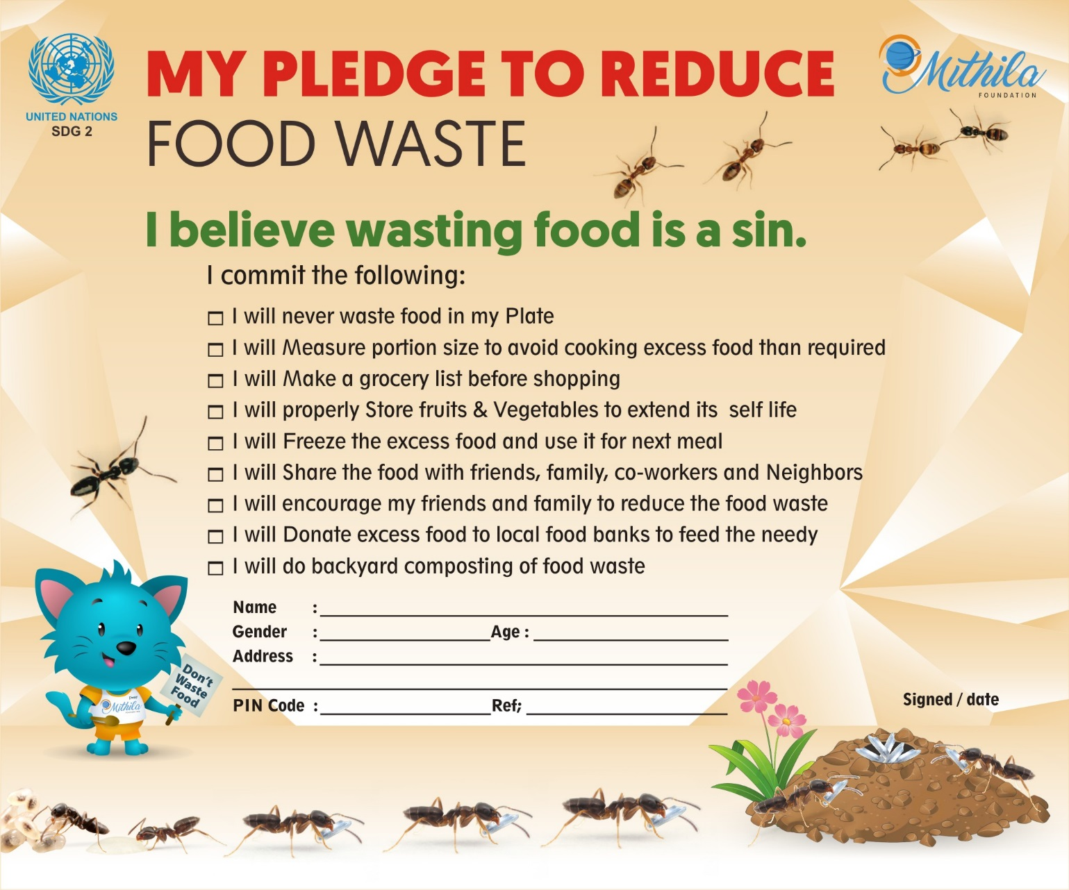
Take a Pledge

