Slide 1
Reduce Food waste
Why & How

Slide 2
Food wastage in Restaurants
Restaurant Management Side
Customer side

Slide 3
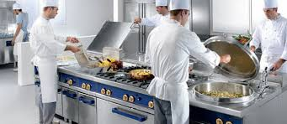
Restaurant Management side Invest in high-quality kitchen equipment
Use specialized knives for peeling of fruits and vegetables or knives for filleting and cutting meat or fish - in the long term have a major impact on reducing waste
Rust free equipment will avoid spoilage of food
Best storage unit will increase food lifetime
Non stick pans helps to avoid more oil consumption and sticky food waste
These are few examples

Slide 4
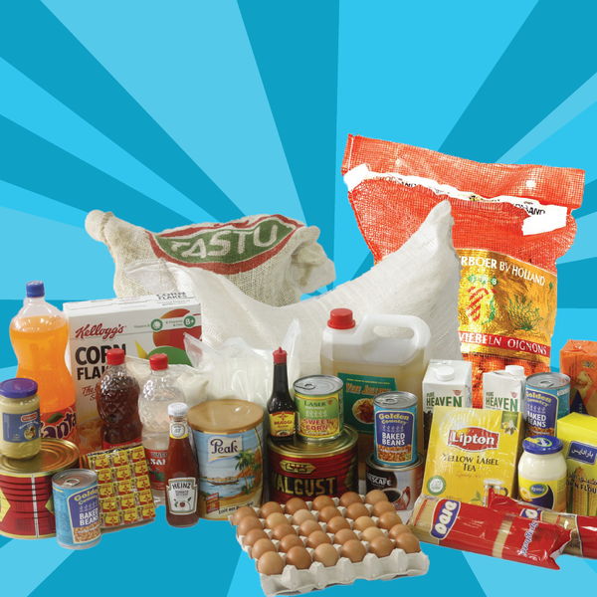
Make a purchase wisely
Some of the ingredients may used rarely so sometime it may waste or not to use before validity period so buy based on that.
Buy small pack it will help to avoid spillage other wise put it in air tight container
Avoid grated cheeses buy block cheese it may lead to avoid more consumption

Slide 5
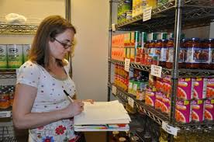
Conduct inventory in the restaurant regularly
Use software for monitoring inventory
Appoint Qualified Person to control inventory system
Monitor Daily consumption
Prepare stock list before going to purchase
Periodically take Long outstanding stock and monitor what type of stock in that list

Slide 6
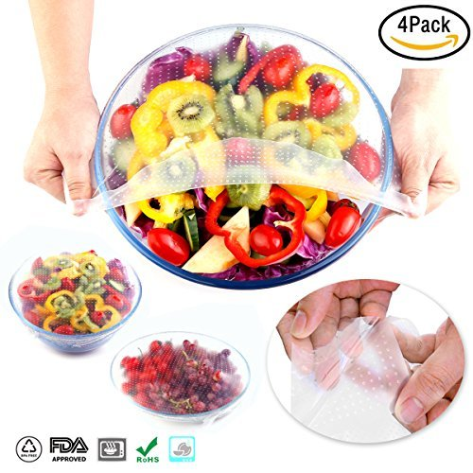
Store fruits and vegetables properly
Before storage separate the fruits and vegetables and arrange based on its life time
Clean all vegetables and fruits before storage
Store in a suitable container with date of storage.
proper storage of food will help to extending the time of use

Slide 7
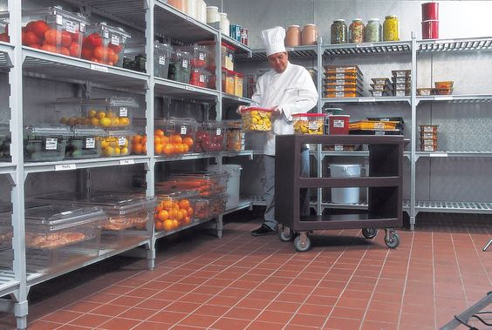
Regularly rotate the food in the fridge and warehouse
Set the foods that should be used first in front of the food that is stored newly.
A very convenient way of storing food in the refrigerator is the rule “right to left”.
New foods always store on the right side of the fridge while existing food you move further to the left.
W hen you taking the food for preparation you are of course using the reverse order “from left to right.” In this way your food will be always fresh and you reducing food waste.

Slide 8
Change your menu
After identify the restaurant menu items that usually have the most leftovers consider reducing the portion size of these menu items.
In this way not only that you reduce the quantity of restaurant waste but also reducing the food cost of cooking and automatically increase profit.

Slide 9
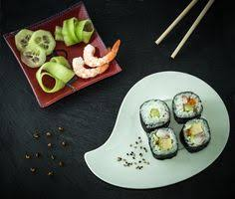
Change your plates
Plates and glasses with smaller volume will seamlessly reduce portions.

Slide 10
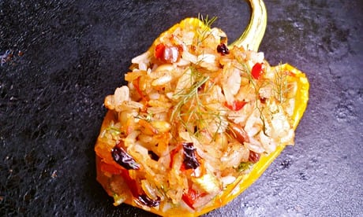
Recycle Menu Items
Leftover chicken breast can be made into a fricassee or pie.
Apple garnishes into an apple sauce.
Or, simply, create a temporary pricing special to move the menu item quickly and before it spoils.
Identify menu items with the most leftovers and remove them from your menu.

Slide 11
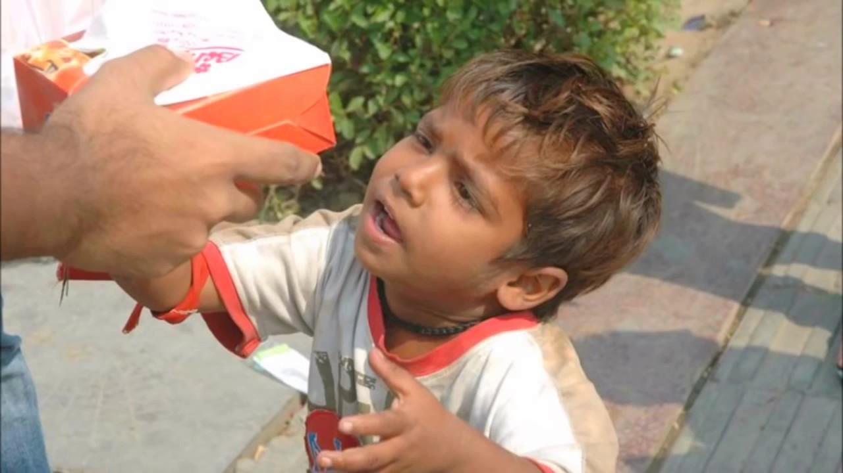
Donate Leftover Food
Many organisations can accept food that has not expired, to be redistributed to households that need it or used to make meals in various shelters and kitchens.
There are many organizations with missions to find and make connections between kitchens and shelters that can use leftover food.

Slide 12
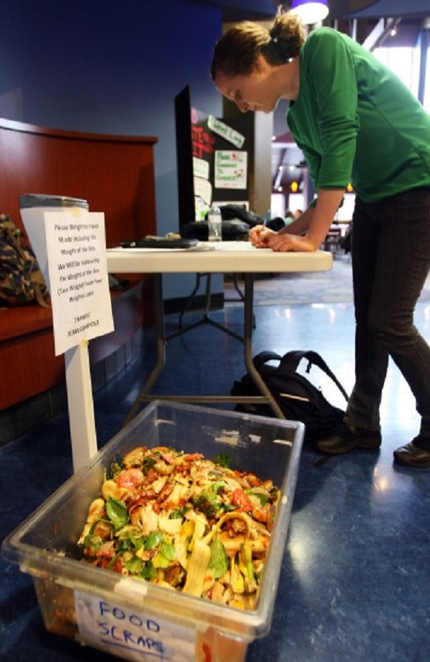
Create a Team Responsible for Managing the Garbage
Hire a professional team to do a waste audit or you can do it with your team because they are familiar with the amount of specific ingredients that are used when preparing certain dishes.
On the other hand, the staff in charge for cleaning and washing dishes are familiar with the type and quantity of garbage that left after customers finish with eating.

Slide 13
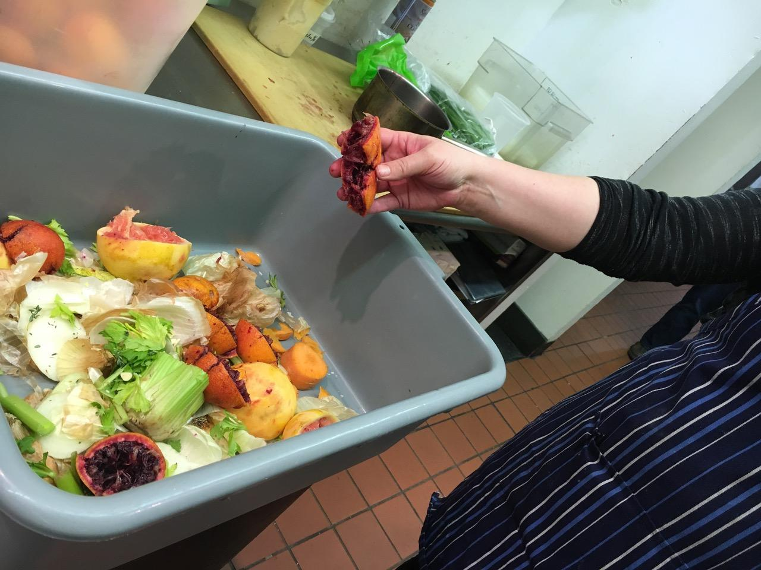
Identifying Quantity of Different Types of Waste
You will Identify your garbage easily through the following actions :
Conversation with the employees
Disposal of garbage in specific containers
Recording of types and quantities of waste
A review of invoices and other documentation
To identify waste is usually sufficient to monitor and analyze it over a period of one month.

Slide 14
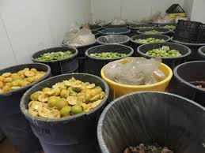
Sorting and Weighing Restaurant Waste
Using different containers for waste
Short waste to the one that can be recycled, such as food packaging, glass, paper, plastic bottles or
Organic waste from the kitchen,
Food scraps that your guests did not eat, all green food that can go to composting.
These main categories can be furthered divided into subcategories such as meat, fresh fruit and vegetables, large plastic bottles, small plastic bottles, etc.
A large number of categories and subcategories provides a clearer picture of the type and quantity of waste and brings more recycling options.

Slide 15
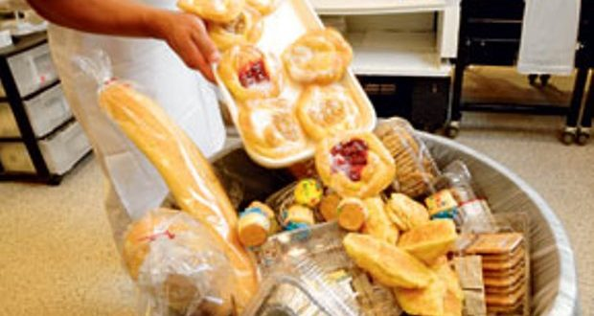
Customer side
Clean Your plate
Split a dish with a friend
Take home leftovers
Order less
Go tray less - it’s harder to carry more food
Don’t go in single go with friends or family memers it help to share food

